Slide 1
Quiz Questions (Pre-Midterm)
Notes:
Version History
8.0 (April 2020)
All slides reformatted for 16:9 aspect ratio
All slides updated to 8th edition material
Use of Calibri font, rather that Gill Sans MT
Add LOTS more animation throughout
added new 8th edition material on QUIC, CUBIC, delay-based congestion control
lighter header font
8.2 (July 2023): changes from 8.0
minor updates throughout, but not much changes from 8.0

Slide 2

Chapter 3: roadmap
Transport-layer services
Multiplexing and demultiplexing
Connectionless transport: UDP
Connection-oriented transport: TCP
segment structure
reliable data transfer
flow control
connection management
Principles of congestion control
TCP congestion control

Slide 3

TCP: retransmission scenarios
IMPORTANT
Host A
Host B
Host A
Host B
1. HostB receives Seq# 92-99 (8 Bytes), and expects the next received Seq# to be 100
SendBase=92
1. HostB receives Seq# 92-99 (8 Bytes), and expects the next received Seq# to be 100
Seq=92, 8 bytes of data
Seq=92, 8 bytes of data
timeout
timeout
Seq=100, 20 bytes of data
ACK=100
3. HostA times out and resends Seq# 92-99 (8 Bytes).
2. HostB receives Seq# 100-119 (20 Bytes), and expects the next received Seq# to be 120
X
ACK=100
ACK=120
2. HostA times out and resends Seq# 92-99 (8 Bytes).
Seq=92, 8 bytes of data
3. HostB receives Seq# 92-99 (8 Bytes), and expects the next received Seq# to be 100
Seq=92, 8
bytes of data
SendBase=100
4. HostB receives Seq# 92-99 (8 Bytes). But it has already received up to Seq# 119, so it sends cumulative
ACK for Seq# 120
SendBase=120
ACK=100
ACK=120
SendBase=120
lost ACK scenario
premature timeout
Notes:
To cement our understanding of TCP reliability, let’s look a a few retransmission scenarios
In the first case a TCP segments is transmitted and the ACK is lost, and the TCP timeout mechanism results in another copy of being transmitted and then re-ACKed a the sender
In the second example two segments are sent and acknowledged, but there is a premature timeout e for the first segment, which is retransmitted. Note that when this retransmitted segment is received, the receiver has already received the first two segments, and so resends a cumulative ACK for both segments received so far, rather than an ACK for just this fist segment.

Slide 4
TCP: retransmission scenarios
Host A
Host B
Q: what happens if the segment with Seq=92, 8 bytes of data from Host A to Host B gets lost?
A: Host B will NOT send ACK=120, since a cumulative ACK=120 implies that all previous segments with Seq < 120 have been received
1. HostB receives Seq# 92-99 (8 Bytes), and expects the next received Seq# to be 100, but the ACK is lost.
Seq=92, 8 bytes of data
3. HostA receives ACK for Seq# 120. This cumulative ACK of Seq# 120 covers for earlier lost ACK of Seq#100, so HostA knows that HostB has received all bytes up to Seq#119, so it can send the next 15 Bytes (Seq#120-134).
Seq=100, 20 bytes of data
ACK=100
2. HostB receives Seq# 100-119 (20 Bytes), and expects the next received Seq# to be 120
X
ACK=120
Seq=120, 15 bytes of data
Notes:
And in this last example, two segments are again transmitted, the first ACK is lost but the second ACK, a cumulative ACK arrives at the sender, which then can transmit a third segment, knowing that the first two have arrived, even though the ACK for the first segment was lost

Slide 5
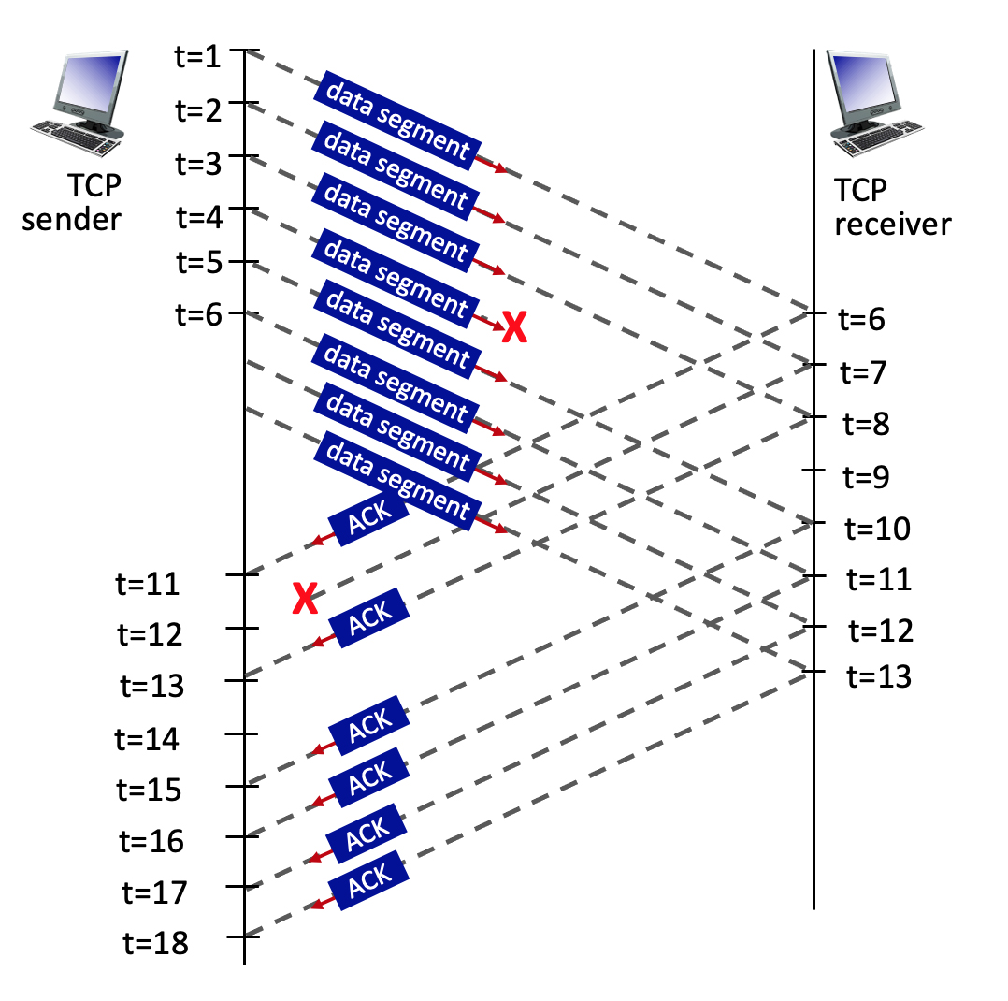
3.5-2a. TCP sequence and ACK numbers.
Consider the figure, where a TCP sender sends 8 TCP segments at t = 1, 2, 3, 4, 5, 6, 7, 8. Suppose the initial value of the sequence number is 0 and every segment sent to the receiver each contains 100 bytes. The delay between the sender and receiver is 5 time units, and so the first segment arrives at the receiver at t = 6. The ACKs sent by the receiver at t = 6, 7, 8, 10, 11, 12 are shown. The TCP segments (if any) sent by the sender at t = 11, 13, 15, 16, 17, 18 are not shown. The segment sent at t=4 is lost, as is the ACK segment sent at t=7.
Q: What is the sequence number of the segment sent at t=2?
A: 0+100=100.
See notes for explanations
Notes:
TCP uses sequence numbers to keep track of the bytes sent in a data stream. Each byte of data is assigned a unique sequence number.
## Given Information
- Initial sequence number: 0
- Each segment contains 100 bytes
- Segments are sent at t = 1, 2, 3, 4, 5, 6, 7, 8
## Calculating the Sequence Number
To find the sequence number of the segment sent at t=2, we need to consider the following:
1. The initial sequence number is 0 for the first segment (t=1).
2. Each segment contains 100 bytes.
3. The sequence number for each subsequent segment increases by the number of bytes in the previous segment.
Therefore:
- Segment at t=1: Sequence number = 0
- Segment at t=2: Sequence number = 0 + 100 = 100
## Explanation
The sequence number for the segment sent at t=2 is 100. This is because:
1. The first segment (t=1) starts with sequence number 0.
2. Each segment contains 100 bytes of data.
3. The second segment (t=2) will have a sequence number that is the sum of the initial sequence number (0) and the number of bytes in the first segment (100).
This pattern would continue for subsequent segments:
- Segment at t=3: Sequence number = 100 + 100 = 200
- Segment at t=4: Sequence number = 200 + 100 = 300
And so on.
It's important to note that the lost segment at t=4 and the lost ACK at t=7 do not affect the sequence numbers of the segments being sent. They would, however, impact the retransmission and acknowledgment process in a real TCP connection.

Slide 6
3.5-2b. TCP sequence and ACK numbers.
Consider the figure, where a TCP sender sends 8 TCP segments at t = 1, 2, 3, 4, 5, 6, 7, 8. Suppose the initial value of the sequence number is 0 and every segment sent to the receiver each contains 100 bytes. The delay between the sender and receiver is 5 time units, and so the first segment arrives at the receiver at t = 6. The ACKs sent by the receiver at t = 6, 7, 8, 10, 11, 12 are shown. The TCP segments (if any) sent by the sender at t = 11, 13, 15, 16, 17, 18 are not shown. The segment sent at t=4 is lost, as is the ACK segment sent at t=7.
Q: What is the ACK value carried in the receiver-to-sender ACK sent at t = 6?
A: 0+100=100. By sending this ACK, the receiver is telling the sender: "I've received everything up to byte 99, and I'm now expecting byte 100."
See notes for explanations
Notes:
## Understanding the Scenario
- The initial sequence number is 0.
- 8 TCP segments are sent at t = 1, 2, 3, 4, 5, 6, 7, 8.
- Each segment contains 100 bytes.
- The delay between sender and receiver is 5 time units.
- The segment sent at t=4 is lost.
- We need to determine the ACK value sent by the receiver at t = 6.
## Calculating the ACK Value
1. **Segments Received**: At t = 6, only the first segment (sent at t = 1) has arrived at the receiver due to the 5-unit delay.
2. **Bytes Received**: The first segment contains 100 bytes.
3. **ACK Mechanism**: TCP uses cumulative ACKs, which means it acknowledges all bytes up to the last contiguously received byte.
4. **ACK Value Calculation**:
- Initial sequence number: 0
- Bytes successfully received: 100
- Next expected byte: 0 + 100 = 100
Therefore, the ACK value carried in the receiver-to-sender ACK sent at t = 6 is 100.
## Explanation
The ACK value of 100 indicates that the receiver has successfully received all bytes up to, but not including, byte 100. It's essentially saying, "I've received everything up to byte 99, and I'm now expecting byte 100."
This ACK value makes sense because:
1. Only one segment has been received (the one sent at t = 1).
2. Each segment contains 100 bytes.
3. The receiver is acknowledging the receipt of the first segment and indicating it's ready for the next byte.
It's important to note that even though more segments were sent by the sender, due to the network delay, only the first segment has reached the receiver at t = 6. The lost segment at t = 4 doesn't affect this initial ACK because it hasn't even reached the receiver yet.

Slide 7
3.5-2c. TCP sequence and ACK numbers.
Consider the figure, where a TCP sender sends 8 TCP segments at t = 1, 2, 3, 4, 5, 6, 7, 8. Suppose the initial value of the sequence number is 0 and every segment sent to the receiver each contains 100 bytes. The delay between the sender and receiver is 5 time units, and so the first segment arrives at the receiver at t = 6. The ACKs sent by the receiver at t = 6, 7, 8, 10, 11, 12 are shown. The TCP segments (if any) sent by the sender at t = 11, 13, 15, 16, 17, 18 are not shown. The segment sent at t=4 is lost, as is the ACK segment sent at t=7.
Q: What is the ACK value carried in the receiver-to-sender ACK sent at t = 8?
A: 300. By sending this ACK, the receiver is telling the sender: "I have received everything up to byte 299. Please send me the next byte, which should be 300."
See notes for explanations
Notes:
To solve this TCP sequence and ACK numbers question, let's break down the scenario and analyze it step by step:
## Initial Conditions
- The initial sequence number is 0.
- Each TCP segment contains 100 bytes.
- 8 TCP segments are sent at t = 1, 2, 3, 4, 5, 6, 7, 8.
- The delay between sender and receiver is 5 time units.
- The segment sent at t=4 is lost.
- The ACK sent at t=7 is lost.
## Analysis
### Segment Arrival
The first segment arrives at the receiver at t = 6 due to the 5-unit delay. This means that by t = 8, the receiver has potentially received the segments sent at t = 1, 2, and 3.
### Sequence Numbers
Given that each segment contains 100 bytes and the initial sequence number is 0, the sequence numbers for the first four segments would be:
- Segment 1: 0-99
- Segment 2: 100-199
- Segment 3: 200-299
- Segment 4: 300-399 (but this segment is lost)
### ACK Behavior
TCP uses cumulative ACKs, meaning it acknowledges all bytes up to the ACK number minus one. The receiver will send an ACK for the highest contiguous sequence number it has received.
## Solution
At t = 8, the receiver has successfully received segments 1, 2, and 3. However, segment 4 (sent at t=4) was lost. According to TCP's cumulative ACK principle, the receiver will acknowledge all data it has received contiguously.
Therefore, the ACK value carried in the receiver-to-sender ACK sent at t = 8 will be 300.
This ACK value of 300 indicates:
1. The receiver has successfully received all bytes up to and including byte 299.
2. The next byte the receiver expects is byte 300.
3. This ACK implicitly acknowledges all previous segments (1, 2, and 3).
By sending this ACK, the receiver is telling the sender: "I have received everything up to byte 299. Please send me the next byte, which should be 300."
It's important to note that even though segments 5, 6, and possibly 7 might have arrived by t=8, the receiver cannot acknowledge them yet because segment 4 is missing, breaking the contiguous sequence of received data.

Slide 8
3.5-2d. TCP sequence and ACK numbers.
Consider the figure, where a TCP sender sends 8 TCP segments at t = 1, 2, 3, 4, 5, 6, 7, 8. Suppose the initial value of the sequence number is 0 and every segment sent to the receiver each contains 100 bytes. The delay between the sender and receiver is 5 time units, and so the first segment arrives at the receiver at t = 6. The ACKs sent by the receiver at t = 6, 7, 8, 10, 11, 12 are shown. The TCP segments (if any) sent by the sender at t = 11, 13, 15, 16, 17, 18 are not shown. The segment sent at t=4 is lost, as is the ACK segment sent at t=7.
Q: What is the ACK value carried in the receiver-to-sender ACK sent at t = 10?
A: 300. By sending this ACK, the receiver is telling the sender: "I have received everything up to byte 299. Please send me the next byte, which should be 300."
See notes for explanations
Notes:
To solve this question, let's analyze the TCP sequence and ACK numbers based on the given information:
## Initial Setup
- The initial sequence number is 0.
- Each segment contains 100 bytes.
- The delay between sender and receiver is 5 time units.
- The segment sent at t=4 is lost.
- The ACK sent at t=7 is lost.
## Sequence of Events
1. Segments sent at t=1, 2, 3 arrive at the receiver at t=6, 7, 8 respectively.
2. The receiver acknowledges these segments at t=6, 7, 8.
3. The segment sent at t=4 is lost and doesn't reach the receiver.
4. Segments sent at t=5, 6, 7, 8 arrive at the receiver at t=10, 11, 12, 13 respectively.
## ACK Value Calculation
To determine the ACK value sent at t=10, we need to consider the last successfully received byte in order.
1. The first three segments (sent at t=1, 2, 3) were successfully received and acknowledged.
- These segments cover bytes 0-99, 100-199, and 200-299.
2. The segment sent at t=4 was lost, so the next expected byte is 300.
3. Even though segments sent at t=5 have arrived by t=10, TCP uses cumulative ACKs.
Therefore, the ACK value sent at t=10 will be 300.
## Explanation
The ACK value of 300 indicates that the receiver has successfully received all bytes up to but not including byte 300. It's requesting the next expected byte, which is 300. This ACK serves two purposes:
1. It acknowledges the receipt of the first three segments.
2. It informs the sender that there's a gap in the received data, prompting a retransmission of the lost segment (sent at t=4).
Even though the receiver has likely received segments sent after the lost one, it cannot acknowledge them yet due to TCP's in-order delivery requirement. This behavior is part of TCP's reliable data transfer mechanism, ensuring that all data is received in the correct order.

Slide 9
Quiz
Host A
Host B
Host A
Host B
1. HostB receives Seq# 92-191 (100 Bytes), and expects the next received Seq# to be 192
1. HostB receives Seq# 92-191 (100 Bytes), and expects the next received Seq# to be 192
Seq=92, 100 bytes of data
Seq=92, 100 bytes of data
timeout
timeout
ACK=192
ACK192
X
2. HostA times out and resends Seq# 92-191 (100 Bytes).
2. HostA sends Seq# 192-291 (100 Bytes).
Seq=92, 100 bytes of data
3. HostB receives Seq# 92-191 (100 Bytes), and expects the next received Seq# to be 192
Seq=192, 100 bytes of data
2. HostB receives Seq# 192-291 (100 Bytes), and expects the next received Seq# to be 292
ACK=192
ACK=292
Received ACK scenario
lost ACK scenario

Slide 10
Quiz
Host A
Host B
1. HostB receives Seq# 92-191 (100 Bytes), and expects the next received Seq# to be 192
Seq=92, 100 bytes of data
timeout
Seq=192, 100 bytes of data
3. HostA receives ACK for Seq# 292. This cumulative ACK of Seq# 292 covers for earlier lost ACK of Seq#192, so HostA knows that HostB has received all bytes up to Seq#291, so it can send the next 100 Bytes
ACK=192
X
2. HostB receives Seq# 192-291 (100 Bytes), and expects the next received Seq# to be 292
ACK=292
Seq=292, 100 bytes of data
ACK=392
Cumulative ACK scenario

Slide 11

Chapter 4 Network Layer:
Data Plane
Computer Networking: A Top-Down Approach 8th edition Jim Kurose, Keith Ross Pearson, 2020
Acknowledgement: Based on the textbook’s website: https://gaia.cs.umass.edu/kurose_ross/index.php
Notes:
Version History
8.0 (May 2020)
All slides reformatted for 16:9 aspect ratio
All slides updated to 8th edition material
Use of Calibri font, rather that Gill Sans MT
Add LOTS more animation throughout
added new 8th edition material on middleboxes (and Internet arch), Net neutrality, buffering …
lighter header font
8.2 (July 2023), changes from 8.0:
some minor updates (e.g., IPv6 stats updated) but not much has changed.

Slide 12
Network layer: “data plane” roadmap
Network layer: overview
data plane
control plane
What’s inside a router
input ports, switching, output ports
buffer management, scheduling
IP: the Internet Protocol
datagram format
addressing
network address translation
IPv6
Generalized Forwarding, SDN
Match+action
OpenFlow: match+action in action
Middleboxes

Slide 13
Packet Scheduling: FCFS
IMPORTANT
packet scheduling: deciding which packet to send next on link
first come, first served
priority
round robin
weighted fair queueing
FCFS: packets transmitted in order of arrival to output port
also known as: First-in-first-out (FIFO)
real world examples?
Abstraction: queue
R
packet
departures
packet
arrivals
queue
(waiting area)
link
(server)

Slide 14
Scheduling policies: priority
IMPORTANT
Priority scheduling:
arriving traffic classified, queued by class
any header fields can be used for classification
high priority queue
arrivals
classify
link
departures
low priority queue
2
send packet from highest priority queue that has buffered packets
FCFS within priority class
1
3
4
5
arrivals
packet in service
1
3
2
4
5
departures
1
3
2
4
5

Slide 15
Scheduling policies: round robin
IMPORTANT
Round Robin (RR) scheduling:
arriving traffic classified, queued by class
any header fields can be used for classification
server cyclically, repeatedly scans class queues, sending one complete packet from each class (if available) in turn
R
classify
arrivals
link
departures

Slide 16
Scheduling policies: weighted fair queueing
IMPORTANT
Weighted Fair Queuing (WFQ):
generalized Round Robin
each class, i, has weight, w_{i}, and gets weighted amount of service in each cycle:
w₁
w₂
R
w_{i}
Σ_{j}w_{j}
classify
arrivals
link
departures
w₃
minimum bandwidth guarantee (per-traffic-class)

Slide 17
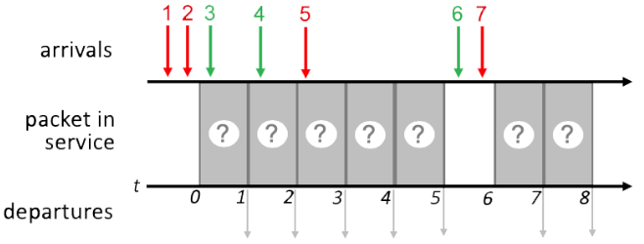
Quiz 1 4.2-7
IMPORTANT

Slide 18
FCFS Scheduling
IMPORTANT
Transmit order the same as packet arrival order of 1 2 3 4 5 6 7
1
2
3
4
5
6
7
1
2
3
4
5
6
7
1 2 3 4 5 6 7

Slide 19
Priority Scheduling
IMPORTANT
Time 0: 1, 2 in queue, transmit 1
FCFS within same priority
Time 1: 2, 3 in queue, transmit 2
Time 2: 3, 4 in queue, transmit 3
FCFS within same priority
Time 3: 4, 5 in queue, transmit 5
Time 4: 4 in queue, transmit 4
Time 6: 6, 7 in queue, transmit 7
Time 7: 6 in queue, transmit 6
1
2
3
5
4
7
6
1
2
3
5
4
7
6
1 2 3 5 4 7 6
Network Layer: 4-19

Slide 20
Round Robin Scheduling
IMPORT
Assume a round-robin scheduling cycle begins with red packets. i.e., (red, green) in each round.
Time 0: 1, 2 in queue, transmit 1
1st round of (red, green)
Time 1: 2, 3 in queue, transmit 3
1st round of (red, green)
Time 2: 2. 4 in queue, transmit 2
2nd round of (red, green)
Time 3: 4, 5 in queue, transmit 4
2nd round of (red, green)
Time 4: 5 in queue, transmit 5
3RD round of (red, green). Since there is no green packet ready, this round is (red, null)
Time 6: 6, 7 in queue, transmit 7
4th round of (red, green)
Time 7: 6 in queue, transmit 6
4th round of (red, green)
Summary:
Times 0-1: 1st round: (1, 3)
Times 2-3: 2nd round: (2, 4)
Time 4: 3rd round: (5, null)
No green packets ready
Times 6-7: 4th round: (7, 6)
1
3
2
4
5
7
6
1
3
2
4
5
7
6
1 3 2 4 5 7 6

Slide 21
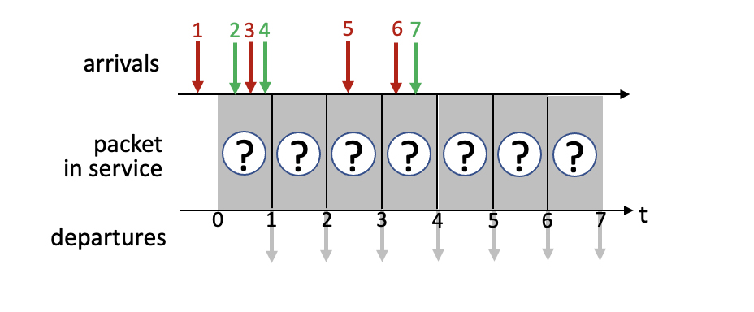
Quiz 2 4.2-3

Slide 22
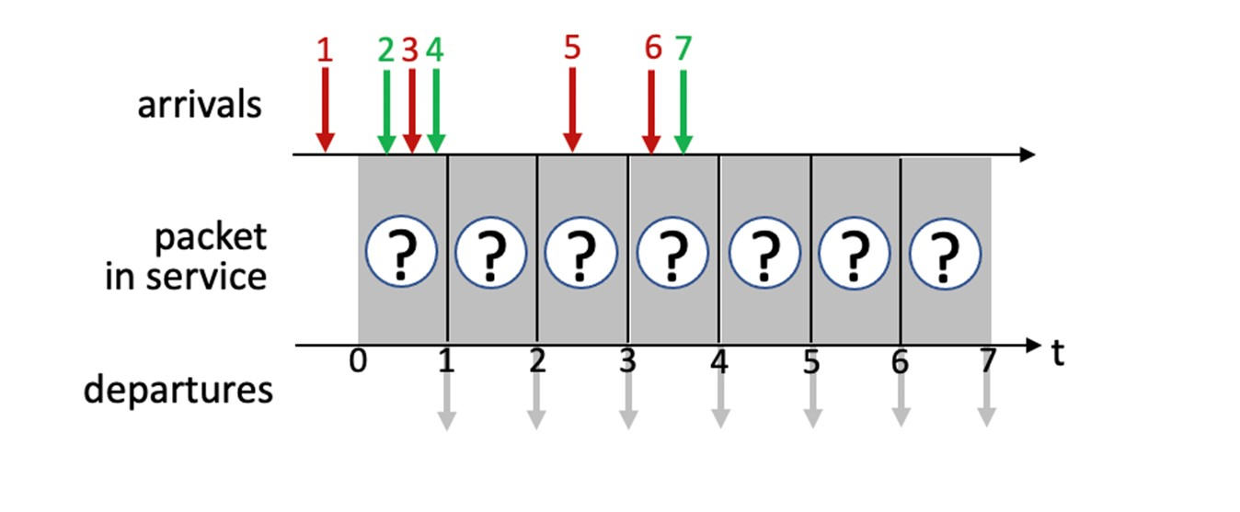
FCFS Scheduling
IMPORTANT
Transmit order the same as packet arrival order of 1 2 3 4 5 6 7
1
2
3
4
5
6
7
1
2
3
4
5
6
7
1 2 3 4 5 6 7

Slide 23
Priority Scheduling
IMPORTANT
Time 0: 1 in queue, transmit 1
Time 1: 2, 3, 4 in queue, transmit 3
Time 2: 2, 4 in queue, transmit 2
FCFS within same priority
Time 3: 4, 5 in queue, transmit 5
Time 4: 4, 6, 7 in queue, transmit 6
Time 5: 4, 7 in queue, transmit 4
Time 6: 7 in queue, transmit 7
1
3
2
5
6
4
7
1
3
2
5
6
4
7
1 3 2 5 6 4 7
Network Layer: 4-23

Slide 24
Round Robin Scheduling
IMPORTANT
Assume a round-robin scheduling cycle begins with red packets. i.e., (red, green) in each round.
Summary:
Times 0-1: 1st round: (1, 2)
Times 2-3: 2nd round: (3, 4)
Times 4-5: 3rd round: (5, 7)
No green packets ready
Time 6: 4th round: (6, null)
1
2
3
4
5
7
6
1
2
3
4
5
7
6
1 2 3 4 5 7 6

Slide 25
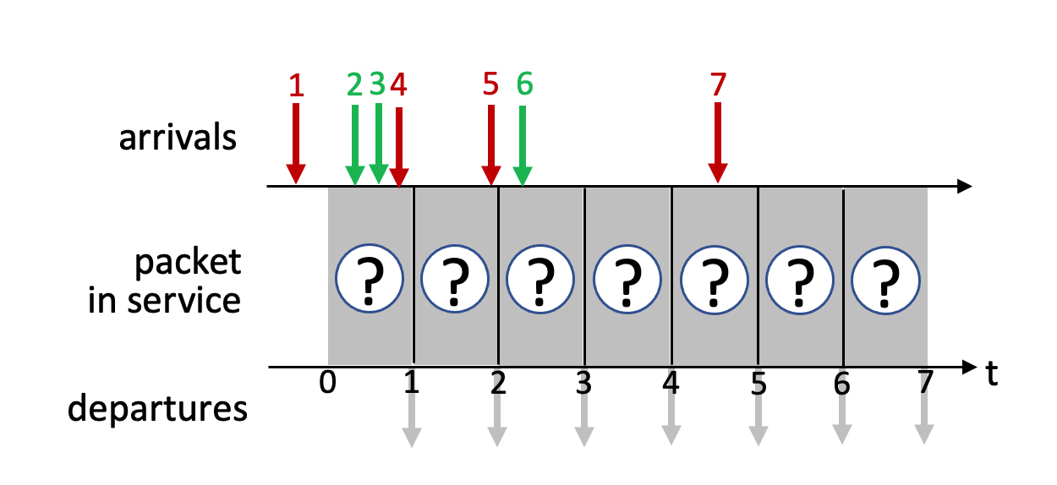
Quiz 3 4.2-4

Slide 26
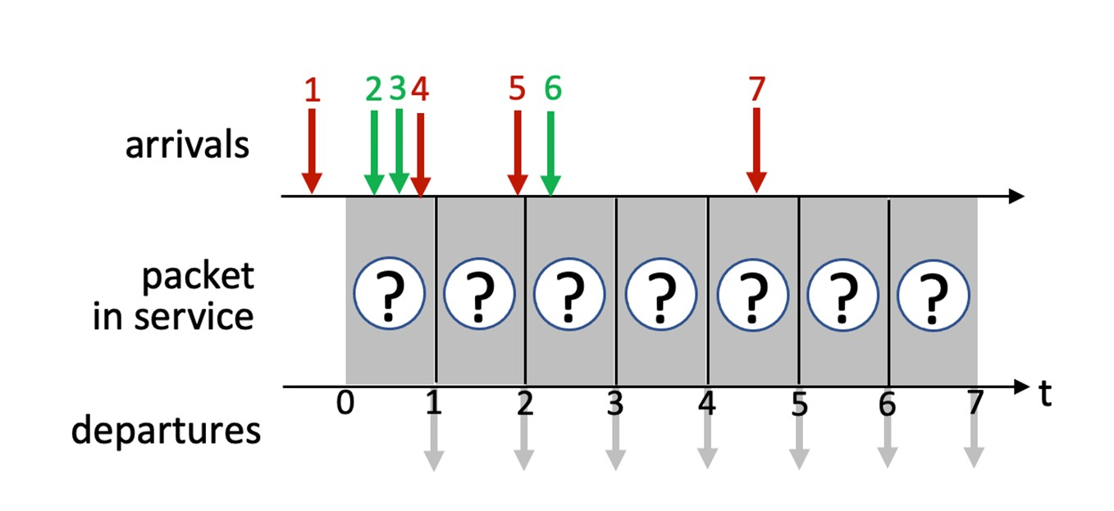
FCFS Scheduling
IMPORTANT
Transmit order the same as packet arrival order of 1 2 3 4 5 6 7
1
2
3
4
5
6
7
1
2
3
4
5
6
7
1 2 3 4 5 6 7

Slide 27
Priority Scheduling
IMPORTANT
Time 0: 1 in queue, transmit 1
Time 1: 2, 3, 4 in queue, transmit 4
Time 2: 2, 3, 5 in queue, transmit 5
Time 3: 2, 3, 6 in queue, transmit 2
Time 4: 3, 6 in queue, transmit 3
Time 5: 6, 7 in queue, transmit 7
Time 6: 6 in queue, transmit 6§
1
4
5
2
3
7
6
1
4
5
2
3
7
6
1 4 5 2 3 7 6
Network Layer: 4-27

Slide 28
Round Robin Scheduling
IMPORTANT
Assume a round-robin scheduling cycle begins with red packets. i.e., (red, green) in each round.
Summary:
Times 0-1: 1st round: (1, 2)
Times 2-3: 2nd round: (4, 3)
Times 4-5: 3rd round: (5, 6)
No green packets ready
Time 6: 4th round: (7, null)
1
2
4
3
5
6
7
1
2
4
3
5
6
7
1 2 4 3 5 6 7

Slide 29
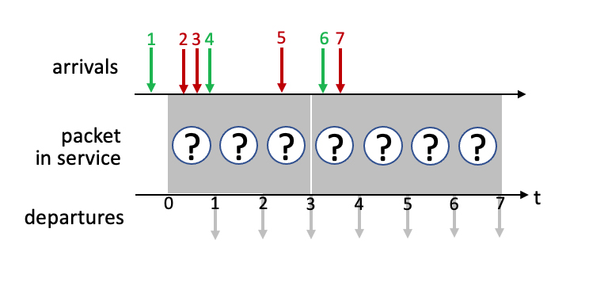
Quiz 4 4.2-1

Slide 30
Quiz 4 4.2-1 Priority
Time 0: 1 in queue, transmit 1
Time 1: 2, 3, 4 in queue, transmit 2
Time 2: 3, 4 in queue, transmit 3
Time 3: 4, 5 in queue, transmit 5
Time 4: 4, 6, 7 in queue, transmit 7
Time 5: 4, 6 in queue, transmit 4
Time 6: 6 in queue, transmit 6
1
2
3
5
7
4
6
1
2
3
5
7
4
6

Slide 31
Quiz 4 4.2-1 Round Robin
Assume a round-robin scheduling cycle begins with red packets. i.e., (red, green) in each round.
Summary:
Times 0: 1st round: (null, 1)
Times 1-2: 2nd round: (2, 4)
Times 3-4: 3rd round: (3, 6)
No green packets ready
Time 5: 4th round: (5, null)
Time 6: 5th round: (7, null)
1
2
4
3
6
5
7
1
2
4
3
6
5
7

Slide 32
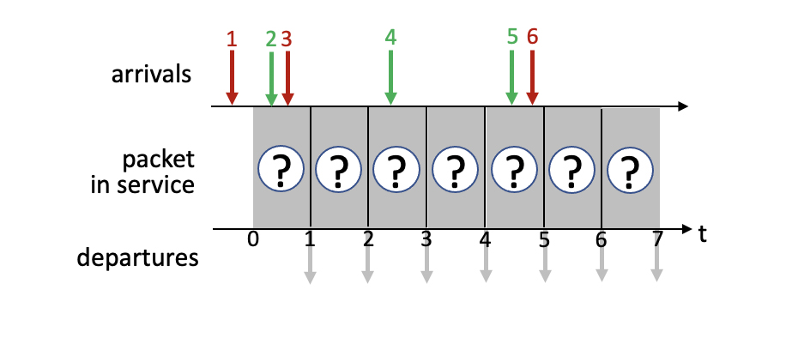
Quiz 5 4.2-2

Slide 33
Quiz 5 4.2-2 Priority
1
3
2
4
6
5
1
3
2
4
6
5

Slide 34
Quiz 5 4.2-2 Round Robin
Assume a round-robin scheduling cycle begins with red packets. i.e., (red, green) in each round.
Summary:
Times 0: 1st round: (1, 2)
Times 1-2: 2nd round: (3, 4)
Times 5-6: 3rd round: (6, 5)
1
2
3
4
6
5
1
2
3
4
6
5

Slide 35
Network layer: “data plane” roadmap
Network layer: overview
data plane
control plane
What’s inside a router
input ports, switching, output ports
buffer management, scheduling
IP: the Internet Protocol
datagram format
addressing
network address translation
IPv6
Generalized Forwarding, SDN
match+action
OpenFlow: match+action in action
Middleboxes

Slide 36
NAT: network address translation
IMPORTANT
NAT: all devices in local network share just one IPv4 address as far as outside world is concerned
rest of
Internet
local network (e.g., home network) 10.0.0/24
10.0.0.1
138.76.29.7
10.0.0.4
10.0.0.2
10.0.0.3
all datagrams leaving local network have same source NAT IP address: 138.76.29.7, but different source port numbers
datagrams with source or destination in this network have 10.0.0/24 address for source, destination (as usual)

Slide 37
NAT: network address translation
IMPORTANT
all devices in local network have 32-bit addresses in a “private” IP address space (10/8, 172.16/12, 192.168/16 prefixes) that can only be used in local network
advantages:
just one IP address needed from provider ISP for all devices
can change addresses of host in local network without notifying outside world
can change ISP without changing addresses of devices in local network
security: devices inside local net not directly addressable, visible by outside world

Slide 38
NAT: network address translation
IMPORTANT
implementation: NAT router must (transparently):
outgoing datagrams: replace (source IP address, port #) of every outgoing datagram to (NAT IP address, new port #)
remote clients/servers will respond using (NAT IP address, new port #) as destination address
remember (in NAT translation table) every (source IP address, port #) to (NAT IP address, new port #) translation pair
incoming datagrams: replace (NAT IP address, new port #) in destination fields of every incoming datagram with corresponding (source IP address, port #) stored in NAT table

Slide 39
NAT: network address translation
IMPORTANT
NAT translation table
WAN side addr LAN side addr
2: NAT router changes datagram source address from 10.0.0.1, 3345 to 138.76.29.7, 5001,
updates table
1: host 10.0.0.1 sends datagram to 128.119.40.186, 80
138.76.29.7, 5001 10.0.0.1, 3345
…… ……
S: 10.0.0.1, 3345
D: 128.119.40.186, 80
10.0.0.1
1
2
S: 138.76.29.7, 5001
D: 128.119.40.186, 80
10.0.0.4
10.0.0.2
138.76.29.7
S: 128.119.40.186, 80
D: 10.0.0.1, 3345
4
S: 128.119.40.186, 80
D: 138.76.29.7, 5001
3
10.0.0.3
3: reply arrives, destination address: 138.76.29.7, 5001

Slide 40
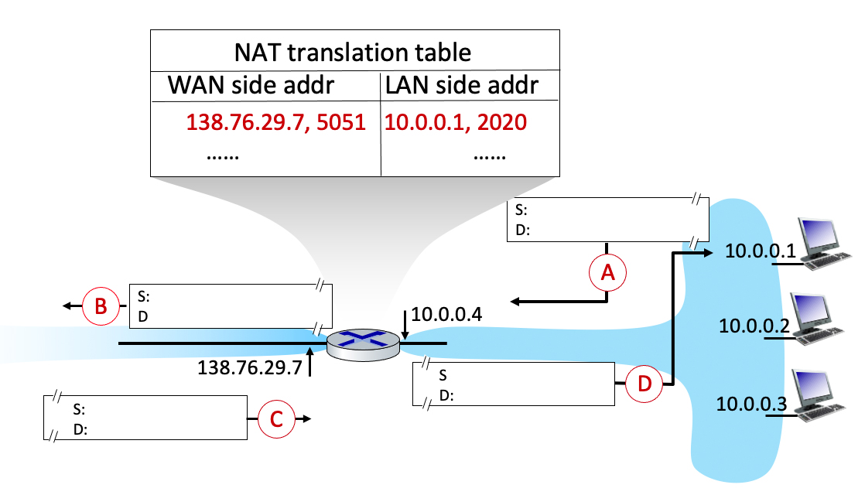
Quiz
4.3-2a Network Address Translation (a). Consider the following scenario in which host 10.0.0.1 is communicating with an external web server at IP address 128.119.40.186, port 80. The NAT table shows the table entry associated with this TCP flow. What are the source and destination IP address and port numbers at points A B C D?

Slide 41
`
S: 10.0.0.1, 2020
D: 128.119.40.186, 80
S: 138.76.29.7, 5051
D: 128.119.40.186, 80
S: 128.119.40.186, 80
D: 10.0.0.1, 2020
S: 128.119.40.186, 80
D: 138.76.29.7, 5051

